Slide 1
STOCK PRICE PREDICTION USING TIME-SERIES MODELS
Group #3
Student Name – Student ID
Trang Bui – 0753523
Sowjanya Chilluveru: 0755566
Sriram bonasu: 0756345

Slide 2
Contribution
Trang Bui: Data Pre-processing, LSTM models + coding combination and doing final conclusion.
Sowjanja: MA model
Sriram: Exponential Smoothing Models

Slide 3
AGENDA
Stock Market - Problem Statement
Time-Series data
2.1 Introduction
2.2 Dataset
Time-Series models
3.1 Moving Average
3.2 Exponential Smoothing (SES, DES, TES)
3.3 LSTM
Evaluation & Results
Conclusion
Q&A

Slide 4
1. Stock market INTROduction
Stock market has become a “hot” investment channel not only for experts but also for any individual investor. Stock market is always risky. In order to achieve high profits, the investors need to thoroughly understand the market and have knowledge of the business including industry outlook, business strategies, financial situation, relationship and effects between stocks and market. Moreover, there are many other methods to help the investor analysis the stock market.
Time-series analysis and forecasting is one of the popular statistical method used for stock price prediction nowadays. There are many algorithms for time series data such as moving average, exponential smoothing, ARIMA, neuron network models (RNN, LSTM). Depending on the series data features, we can use the proper time-series techniques to apply for forecasting.

Slide 5

2.1 Time-series data introduction
What is time-series data?
A series of data points taken from the same source and measured and ordered over a period of time.
Time-series data can be classified into two types:
regular time intervals (metrics)
irregular time intervals (events)
Time-series data components?
Trend: movement along the term
Seasonality: seasonal changes
Cyclicity: change repeat over a certain time
Residual: irregular variations
Time-series is usually used for some analysis applications
Stock price
Exchange Rate, interest rate
Retail Sales
Power Consumptions / Demand
Etc.

Slide 6
2.2 Dataset
We will directly use stock data from https://ca.finance.yahoo.com/.
In this project, we select historical stock price data of Dow Jones Industrial Average (“DOW”) for time-series model training. The amount of used data is at least in 3 recent years period. And, we use feature “Close” for the target.
Data attributes:
Date - the date
Open – the stock's opening price
High – for That day's high price
Low – for That day's low price
Close – for the closing price of the day
Volume – as of the sum of stocks exchanged in the day.
Adj Close – indicates the closing price of the stock that has been changed to include any distributions / corporate actions that occur before opening the next day.

Slide 7
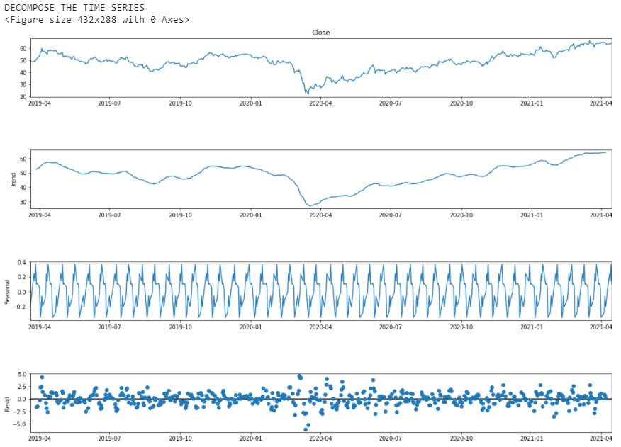
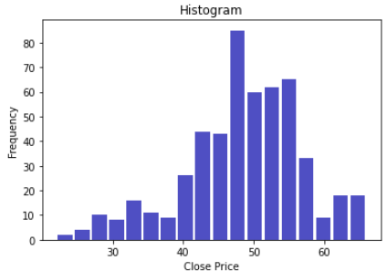
2.2 Dataset - decomposition
The stock prices fluctuated in the range [40,60]. The price abnormally went down bottom on April-2020
The stock prices are quite stable, no trend can be clearly seen.
There is seasonal pattern in this data.
Residual error is between [-5,5].
Histogram
25%. 50%, 75% percentiles shows that around 50% data rows distributes densely in the range of 25th and 75th percentile. The number out of the percentile range is around one-half. Hence, the shape look left-skewed.

Slide 8

3. Time series data analysis
Moving Average
Exponential Smoothing
Simple (SES)
Double (DES)
Triple (TES)
LSTM

Slide 9
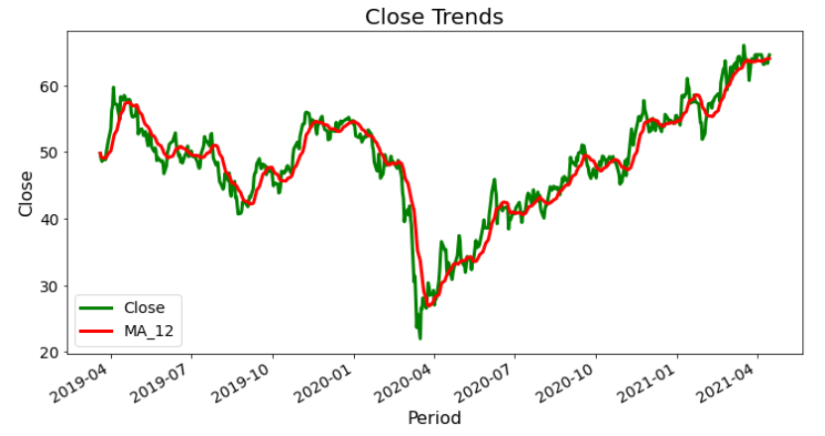
3.1 Moving Average
MA is one of the simplest forecasting model known as “rolling mean” and be calculated by average data of the time series in a certain time period. It is based on the idea that future demand is similar to the recent demand we observed.
In this project, the stock prices prediction is the average of the demand during the last 60 days period.
The value obtained for MAE (Mean absolute error) is 1.74, MSE (Mean Square Error) is 5.66, and RMSE (Root Mean Square Error) is 2.38.

Slide 10
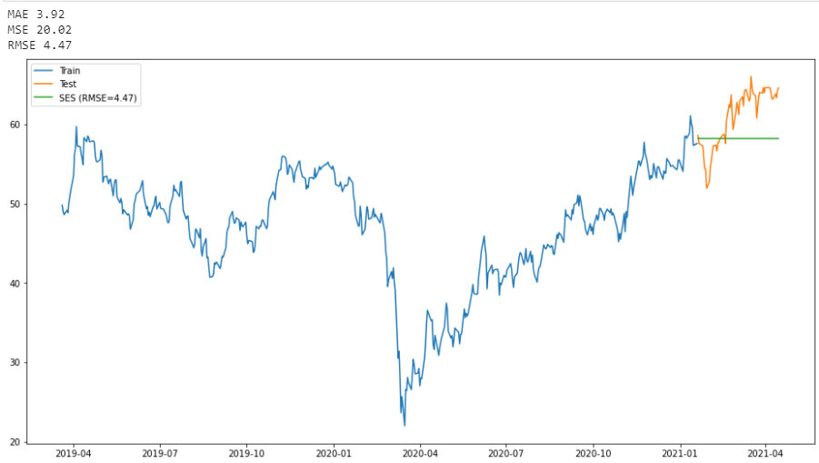
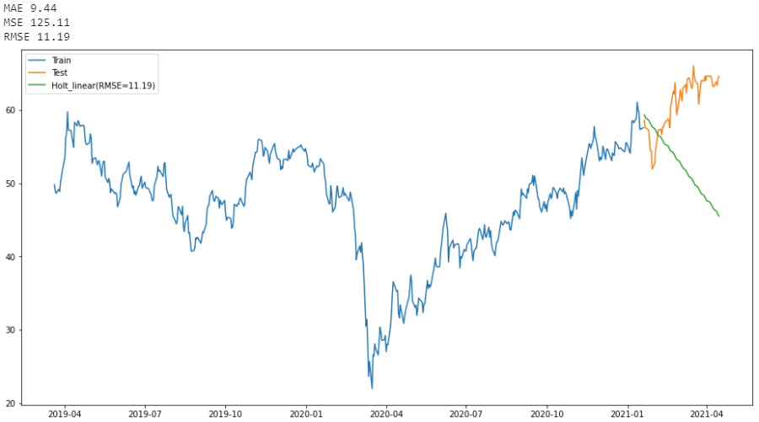
3.2 Exponential smoothing
Single ES (SES)
DOUBLE ES (DES)
This is a time series forecasting method for univariate data without a trend or seasonality. The idea is to assume that the future will be more or less the same as the recent past. The only pattern that this model will be able to learn from demand history is its level.
In this work, we tested the model with some smoothing level alpha = (0.2,0.4, 0.6,0.8) but the result is not really good. The predicted prices are much different with actual prices.
This model is very similar to SES. However, it can estimate the trend in time series data.
In this work, we tested the model with some smoothing level alpha = (0.1, 0.3,0.5) and smoothing slope (beta) = 0.4. thi model looks bad because the in-sample prediction is much different from actual values.

Slide 11
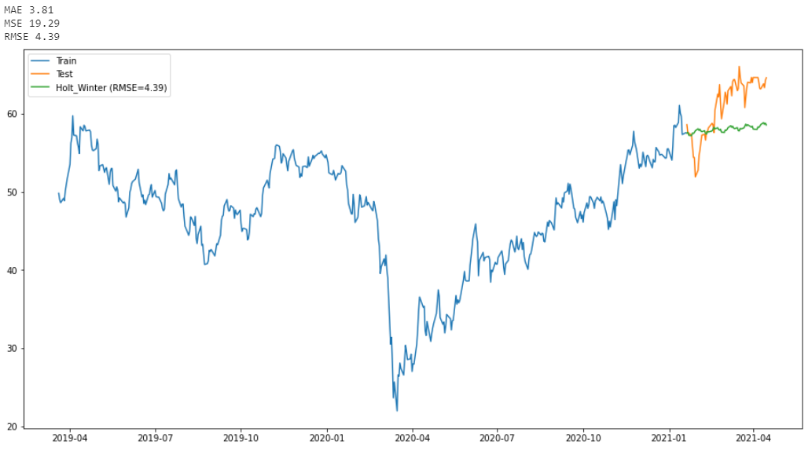
3.2 Exponential smoothing (cont.)
TRIPLE ES (TES)
Different from SES and DES, TES can acknowledge the seasonality in data.
TES provides a fluctuating line with a bit upward direction. However, it is still not a good model.

Slide 12
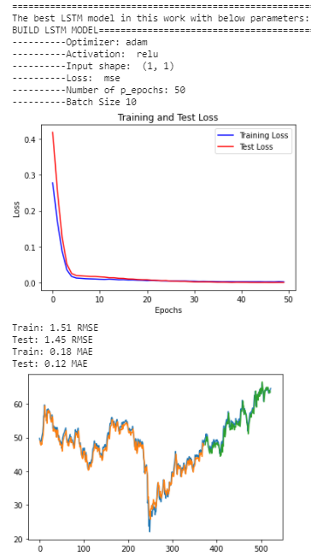
3.3 long-short term memory (lstm)
Long-short term memory model is a form of RNN that includes input layer, hidden layers, and output layer. However, each cell of LSTM has 3 gates that are “input gate”, “output gate”, “forget gate”. Activation function is applied to support input data processing and output data decision making.
In this work, we create a simple Sequential model includes 1 layer LSTM and 1 layer Dense.
Time step is 1 to predict 1 value.
Model is tried with combination of optimizers (‘adam’,’rmsprop’,’sgd’), activations (‘relu’,’sigmoid’,’tanh’), loss functions (‘mse’,’binary_crossentropy’). The most fitting model is found with optimizer ‘adam’, activation ‘relu’, the loss function ‘mse’. The model is trained with 50 epochs and batch_size = 10.

Slide 13
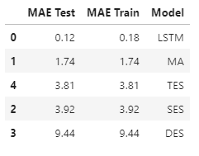
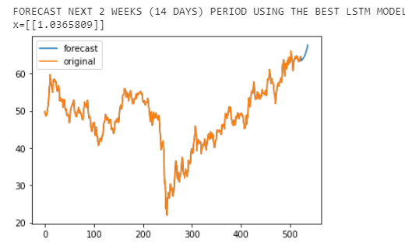
4. Evaluation & result
Evaluation method
In this project, we use the MAE “Mean Absolute Error ” as an estimator for model performance because it is known as a very good KPI to measure forecast accuracy.
It is the mean of the absolute error. The error can be understood as the difference between the estimated values and the actual values. Therefore, the lower error is, the better model is.
Results
MAE of LSTM model is the smallest that are 0.18 for training phase and 0.12 for test phase within sample. The forecast for next 2 weeks (14 days) tends to go up.
MA and Exponential Smoothing Models are not well fit due to larger MAE.

Slide 14
5. Conclusion
In this project, we practiced some learnt time-series methods to create stock price prediction model. The best model looks good in train and test phases within sample data. However, we cannot evaluate for out-of-sample data.
Moreover, we need to investigate to do comprehensive evaluation process to make sure model performance. For example: monitor training and testing phases to evaluate model fitting (over/under or well fit), or training / testing / forecasting duration, ect.)

Slide 15


Slide 16

QUESTIONS

